Slide 1

Contents:-
Rules of Boolean Algebra
Laws of Boolean Algebra
Simplification of Boolean Expressions

Slide 2


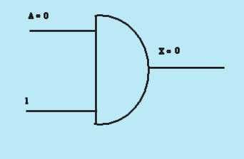
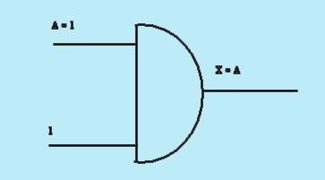
Rules of Boolean Algebra
Rule 1:- A.1 = A
A variable Anded with 1 is always equal to variable

Slide 3

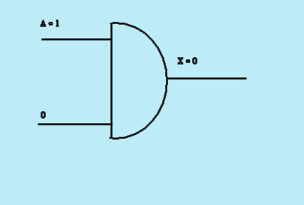

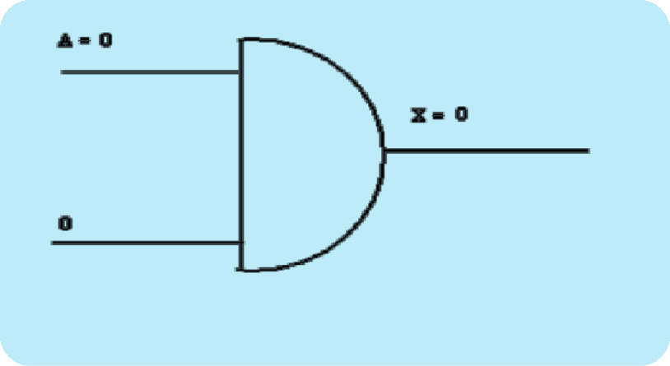
Rules of Boolean Algebra(contd…)
Rule 2:- A. 0 = 0
A variable Anded 0 is always equal to 0

Slide 4

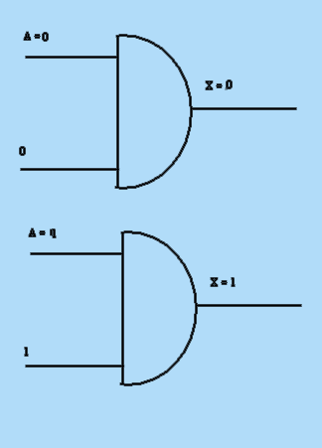
Rules of Boolean Algebra(contd…)
Rule 3:- A.A=A
A variable anded itself to the variable. If A=0 then 0.0=0, If A = 1 then 1.1=1
X=A.A=A

Slide 5
Rules of Boolean Algebra(contd…)
Rule 4:-A.A=0
A variable Anded with its compliment is always equal to zero. If A=1 A. A= 1.1=1.0=0
If A=0 A.A=0.0=0.1=0
A=1 A.A =0
A =0
A=0
A.A =0
A=1

Slide 6
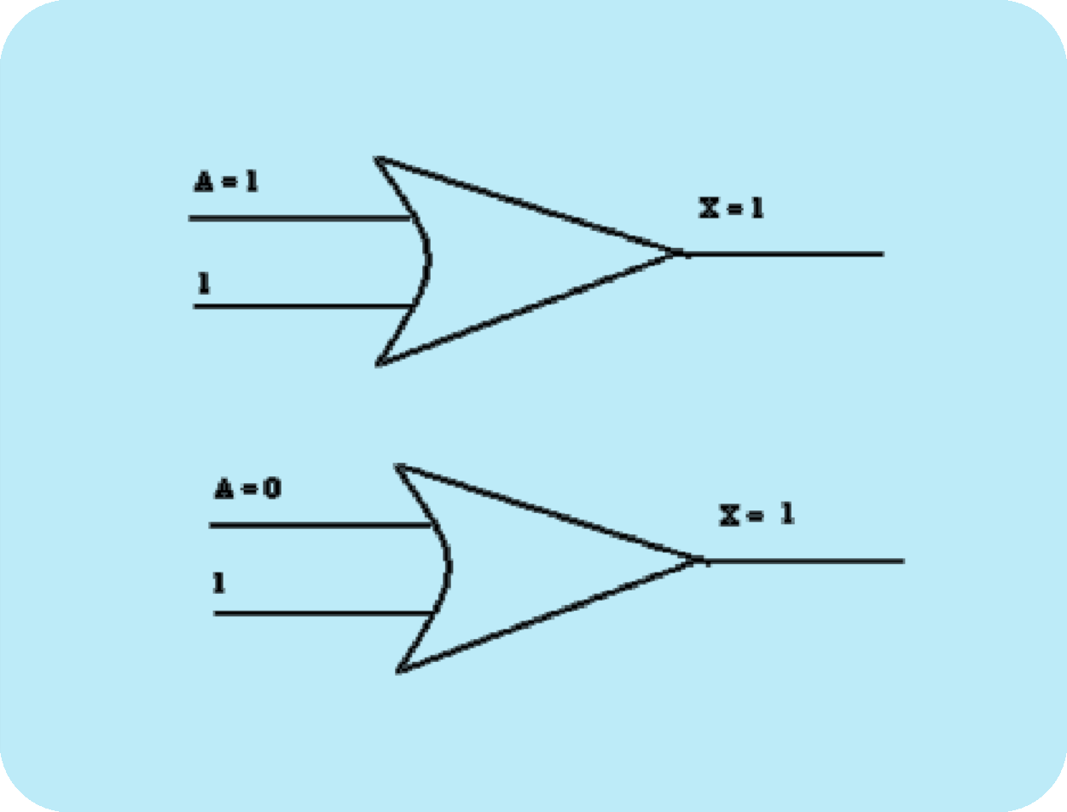
Rules of Boolean Algebra(contd…)
Rule 5:- A+1 = 1
A variable ored with 1 is always equal to 1

Slide 7
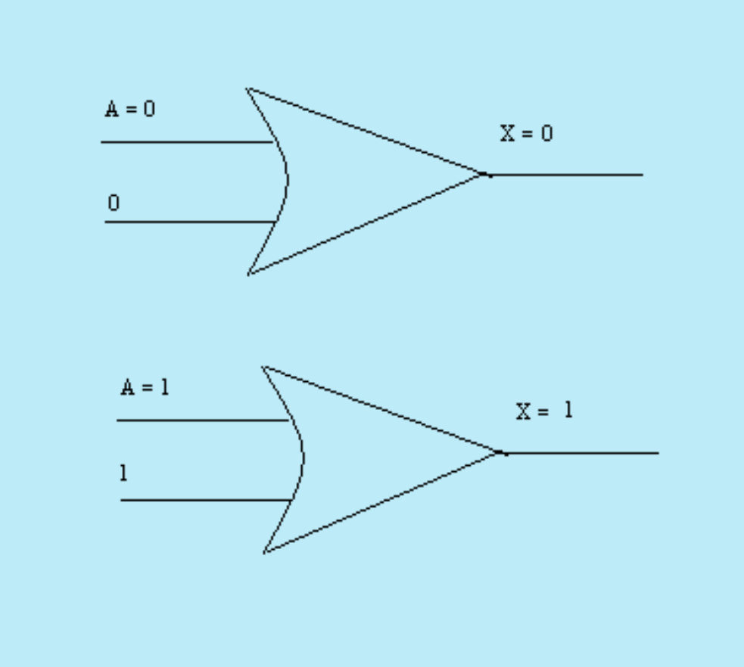
Rules of Boolean Algebra(contd…)
Rule 6:-A + A = A
A variable ored with itself is always equal to the variable
X=A+A=A

Slide 8
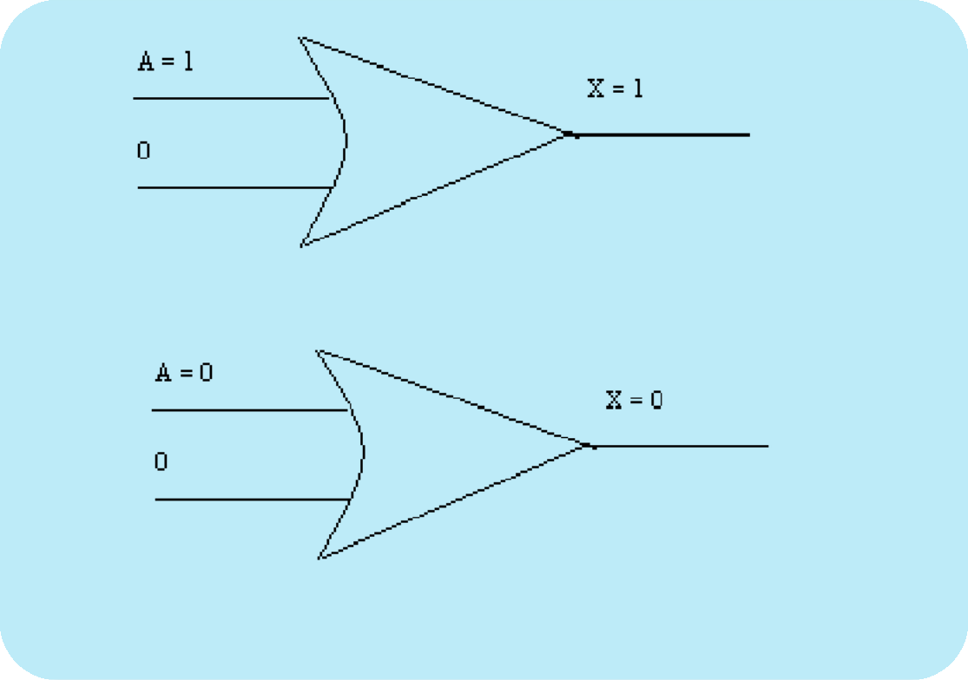
Rules of Boolean Algebra(contd…)
Rule 7:- A + 0 = A
A variable ored with 0 is always equal to variable.
If input variable A is 1 the output variable X is 1 which is equal to A. if A is 0 the output is 0 which is equal to A.

X = A + 0
Her e lowered input fixed at 0
Here lowered input fixed at 0

Slide 9
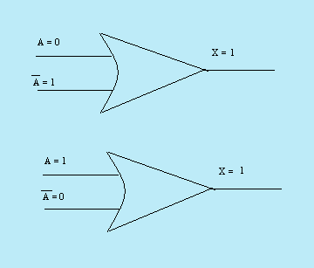
Rules of Boolean Algebra(contd…)
Rule 8:- A+A=1
A variable ORed with its compliment is always equal to 1. If A=1 then A+A=1+1=1+0=1
If A=0 then A+A=0+0=0+1=1
X=A+A=1

Slide 10
Rules of Boolean Algebra(contd…)
By rule 1+B=1
Eq (1)
L.H.S=A(1)
=A=R.H.S
Diagramatically it is shown as
A
A+AB A
AB
TRUTH TABLE:-
A | B | AB | A+AB
0 | 0 | 0 | 0
0 | 1 | 0 | 0
1 | 0 | 0 | 1
1 | 1 | 1 | 1

Slide 11
Rules of Boolean Algebra(contd…)
RULE:-11 A+AB=A+B
Proof:-
L.H.S =A+AB (1)
By rule A+AB=A (2)
Using (2) in (1)
Eq(1) A+AB+AB
By rule A=AA
L.H.S=AA+AB+AB
By rule AA=0
Eq (3)

 =(A+B)(A+A)
By rule A+A=1
Eq (4)

(3)
=AA+AB+AA+ AB
=A(A+B)+A(A+B)
(4)
= (A+B)(1)
=A+B=R.H.S

Slide 12

Rules of Boolean Algebra(contd…)
Diagramatically it is shown as
A
A+AB
A
A+B
A
AB
=
B
B
TRUTH TABLE :-
A | B | A | AB | A+AB | A+B
0 | 0 | 1 | 0 | 0 | 0
0 | 1 | 1 | 1 | 1 | 1
1 | 0 | 0 | 0 | 1 | 1
1 | 1 | 0 | 0 | 1 | 1

Slide 13
Boolean Addition :-
Boolean addition is equivalent to OR gate or operation. In logic circuits a sum of term is produced by an OR operation with no AND operation involved. Some examples of sum terms are
A+B,A+B,A+B+C and A+B+C+D
Boolean Multiplication:-
Boolean multiplication is equivalent to the AND operation. In logic circuit a product term is produced by an AN D operation with no OR operation involved.Some examples of Product terms are AB,ABC,ABC,ABCD
Variable:-
A variable is a symbol used to represent a logic quality. Any variable can have a 1 or 0
value.
Complement:-
A complement is a inverse of a variable and it is indicated by a bar (-) over the variable. For example the complement of a variable A=A. If A=1 then A=0.
the complement of A is read as “not A” or “A”
Literal: -
A literal is a variable or the complement of the variable

Slide 14
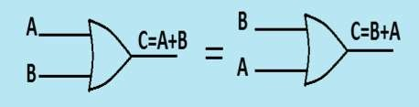
Laws of Boolean algebra:
Commutative law:
Boolean algebra obeys the commutative law of addition. the commutative law of addition for two variables is written as.
A+B=B+A
This law States that the order in which variables are ORed makes no difference. Symbolically it is shown as.
(b) Commutative law for multiplication for two variables:-
AB=BA
This states that the order in which the variable ANDed s makes no difference.
Symbolically it is represented as:

Slide 15
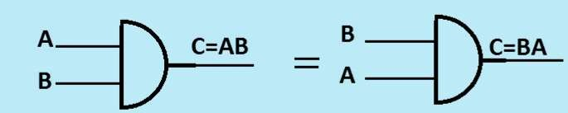
Laws of Boolean algebra:(contd…)
Associative law:
(a) For addition:-
The associative law of addition for three variables is written as:
A+(B+C) = (A+B)+C
This law states that when ORing more than two variables the result is the same regardless of the grouping of variables.
Diagrammatically it is shown as:-

Slide 16
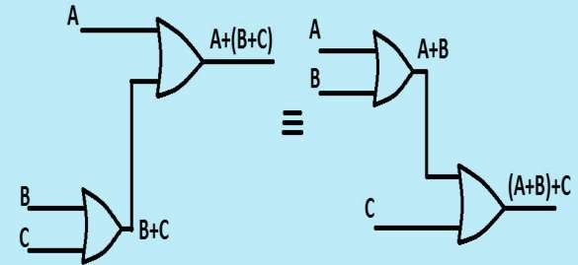
Laws of Boolean algebra:(contd…)
(b) Associative law for multiplication for three variables:-
The associative law for multiplication for three digits is written as.
A(BC) = (AB)C
This law states that when ANDing more than two variables the result is the same regardless of the grouping of variables.
Diagrammatically it is shown as below:-

Slide 17
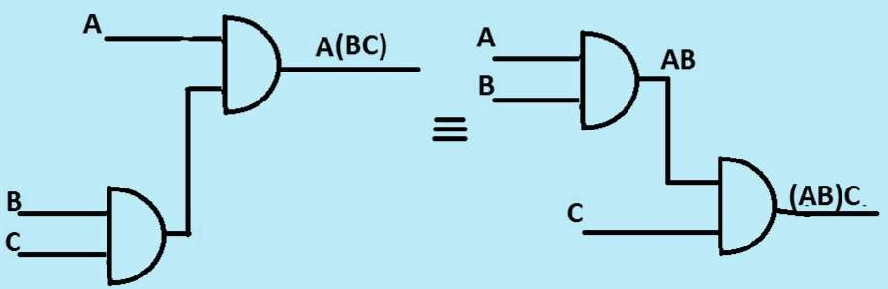
Laws of Boolean algebra:(contd…)
Distributive law: -
This law states that ORing two or more variables and than ANDing the result with single variable is equivalent to ANDing the Single variable with each of two or more than two variables and than ORing the product.
Diagrammatically it is shown below:

Slide 18
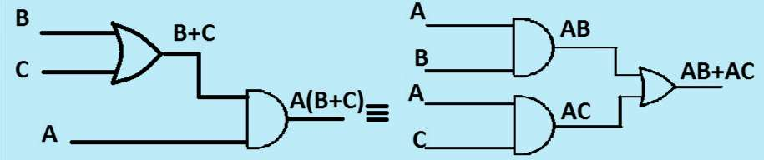
Laws of Boolean algebra:(contd…)

Slide 19
Simplification of Boolean Expressions:-
Using Boolean techniques simplify the following expressions Q.1:- (A+B)(A+C)=A+BC
Sol: L.H.S(A+B)(A+C)
By using distributive law
=AA+AC+AB+BC
By rule AA=A
=A+AC+AB+BC
(1)
=A(1+C)+AB+BC (2)
By rule 1+C=1
Eq(2)
=A(1)+AB+BC
=A+AB+BC
=A(1+B)+BC
(3)
By rule 1+B=1
Eq(3)
=A(1)+BC
=A+BC =R.H.S

Slide 20
Simplification of Boolean Expressions: (contd…)
A | B | C | (A+B) | (A+C) | (A+B)(A+C) | BC | A+BC
0 | 0 | 0 | 0 | 0 | 0 | 0 | 0
0 | 0 | 1 | 0 | 1 | 0 | 0 | 0
0 | 1 | 0 | 1 | 0 | 0 | 0 | 0
0 | 1 | 1 | 1 | 1 | 1 | 1 | 1
1 | 0 | 0 | 1 | 1 | 1 | 0 | 1
1 | 0 | 1 | 1 | 1 | 1 | 0 | 1
1 | 1 | 0 | 1 | 1 | 1 | 0 | 1
1 | 1 | 1 | 1 | 1 | 1 | 1 | 1

Slide 21
Simplification of Boolean Expressions: (contd…)
Diagramtically it is shown as
A+B A
(A+B)(A+C)
A A+C = B
C C
A+BC
BC

Slide 22
Simplification of Boolean Expressions:-
Q.2:- AB + A(B+C) + B(B+C)
Step 1: Apply distributive law to second and third term.
AB + AB + AC + BB + BC
Step 2: Apply rule BB=B to the fourth term
AB + AB + AC + B + BC AB + AB + AC + B(1+C)
Step 3: Apply rule 1+C=1 to fourth term
AB + AB +AC+ B(1)
Step 4: Apply rule drop ‘1’ to fourth term AB + AB +AC+ B
Step 5: Apply the rule AB + AB = AB on first two terms
AB +AC+ B AB+B+AC

Slide 23
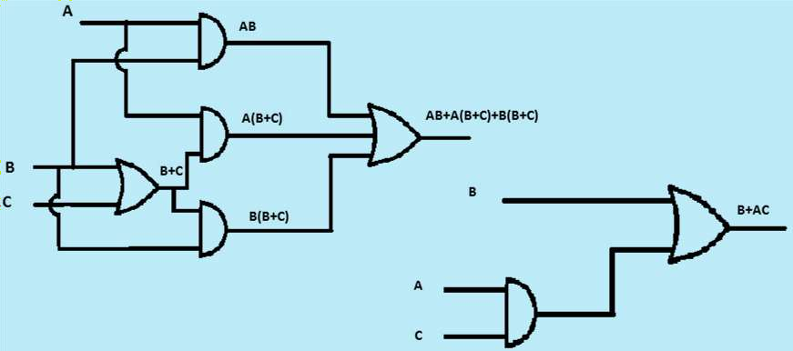
Simplification of Boolean Expressions:-
B(A+1)+AC
Step 6: Apply the rule A+1 = A to first term
B(1)+AC
Step 7: Apply the rule drop ‘1’ to first term B+AC

Slide 24
Simplification of Boolean Expressions:-

B(A+1)+AC
Step 6: Apply the rule A+1 = A to first term
B(1)+AC
Step 7: Apply the rule drop ‘1’ to first term B+AC

Slide 25
Simplification of Boolean Expressions:-
Q.3:- [AB(C+BD)+AB ]C
Step 1: Apply the distributive law [ABC+ABBD+AB]C
Step 2: Apply the rule BB = 0
[ABC + A.0.D + AB]C
Step 3: Apply the rule drop ‘0’ to second term we get [ABC + AB]C
Step 4: Apply distributive law ABCC + ABC
Step 5: Apply the rule CC = C
ABC + ABC BC(A+A)

Slide 26


Simplification of Boolean Expressions:-
Step 6: Apply the rule A + A = 1 BC (1)
Step 7: Apply rule Drop ‘1’
BC
C
AB(C+BD)+AB
B
C+BD
D
BD
AB(C+BD)
C[AB(C+BD)+AB]
A
AB
B
B
AB(C+BD)+AB
A B
A B

Slide 27

Simplification of Boolean Expressions:-
B BC
C
Q.4:- ABC + AB C + ABC + ABC + ABC
Step 1:- Takinq out BC common from first and last term
BC (A + A) + ABC + A B C + ABC
Step 2:- Apply rule A + A = 1
BC (1) + ABC + A B C + ABC
Step 3:- Apply rule drop ‘1’ to first term
BC + ABC + A B C + ABC
Step 4:- Taking out AB common from second and last term
BC + AB (C + C) + ABC
Step 5:- Applying rule C + C = 1
BC + AB (1) + ABC
Step 6:- Apply rule drop ‘1’ to second term
BC + AB + ABC
Step 7:- Taking out B out common from second and last term

Slide 28
Simplification of Boolean Expressions:-
BC + B(A+A C)
Step 8:- Apply A+AC=A+C
BC + B(A+C)
Step 9:- Apply Distributive law to second term BC + BA+BC

Slide 29
Simplification of Boolean Expressions:-
A
B ABC
C
A B C
AB C
ABC+ABC+AB C+ABC+ABC
A
A B C
B C
A
B C
A B C
A
ABC
B
C

Slide 30
Simplification of Boolean Expressions:-
• = B BC
C



B
A
BC+ BA+ B C
BA
BC

